Slide 1
Make Your Own Rain Building A Caseload
Alliance of Women Trial Lawyers
September 7-9, 2019

Slide 2
Making Your Own Rain Building a Caseload
Branding
Niche Marketing
Optimizing Resources

Slide 3
Branding
Careful who you listen to
How do I want the world to see me?
Is this off-brand?
Can my brand evolve?
Protect the brand

Slide 4
Branding
Careful who you listen to

Slide 5
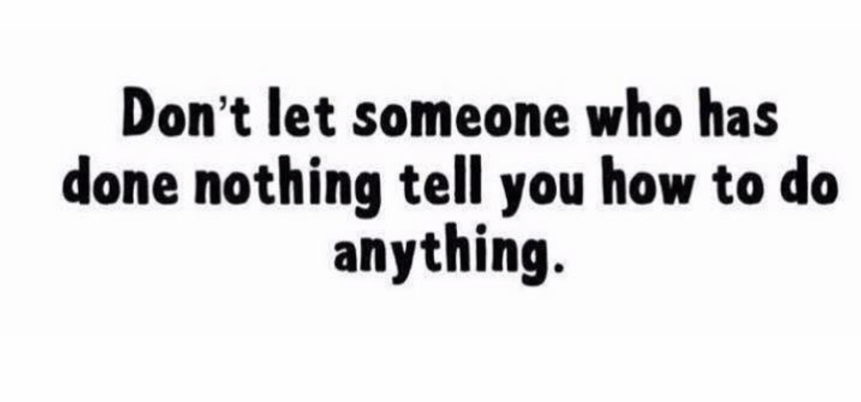

Slide 6
Branding
How do I want the world to see me?
Champion for women
Tough
Direct
Empathetic
Relatable

Slide 7
Branding
Is this off-brand?
Depressed
Victim
Negative
Radio show - political

Slide 8
Branding
Can my brand evolve?
Too narrow?
Too vague?
Hard to maintain?

Slide 9
Branding
Protect the brand

Slide 10
Branding
Protect the brand
Letters of reference – clients and bosses
Reviews and testimonials
Maintain it
Third-party validation
Surrogate defense

Slide 11
Niche Marketing PILMMA
Sell them on the emotional connection to YOU/YOUR FIRM
80% of purchasing is linked to likability
Logic reinforces emotion
Make them want to hire YOU
Credentials are just reinforcement

Slide 12
Niche Marketing PILMMA
The Emotional Sale
Empathy
What are they feeling?
What is most important to them?
How can you make their lives better in some way?
Appeal to emotion
Genuine. From actual experiences.
Cannot fake emotional connections.

Slide 13
Niche Marketing PILMMA
How?
Think of raving fan client (testimonials)
What did you do that went above and beyond and made them super fans?
Tell that story to perspective clients.
Let them see you through the people you’ve helped.

Slide 14
Niche Marketing PILMMA
Identify your strengths
Give back to community
Exemplary customer service
Why does it matter? So what? So what? So what?
“Available 24/7 home, office, or hospital”
vs.
“We meet our clients in their homes to make the process a little more comfortable for them.”

Slide 15
Niche Marketing PILMMA
Know your prospective clients.
They are NOT “anyone who has been injured” or “injured people.”
They do not identify as members of that group.
What are their biggest headaches/worries/frustrations?
How has this impacted them?
Deepest desires/goals?

Slide 16
Niche Marketing-PILMMA Before/After Client Grid
Mark Smith | Before | After
Have | 2015 F150 Truck | No car, upside down $
Feel | Good most days, upbeat and positive | 8/10 pain in neck, back, and left arm, depressed, don’t want to leave the house
Average Day | Worked 8 hours, slept at least 8 good hours, played softball | Take narcotics 24/7, groggy, can only work 4 hours a day, in bed most of the time
Status | Leader in community, on non-profit boards, coached soccer | Loser. People stopped checking in, wife moved to mom’s, no interest in activities

Slide 17
Niche Marketing-PILMMA Build a Client Avatar
Goals and values
Challenges and Pain Points
Sources for Information – books magazines, blogs/websites, gurus,
Interests, vacation/vocations
Objectives and Role in Purchase Process
Age, gender, marital status, children, location
Fears and anxiety
Get on Quora or Avvo for questions asked
After just a few avatars, your prospective client will emerge

Slide 18
Niche Marketing PILMMA
Write to connect emotionally
Message = what makes you/your firm unique + what you know about your clients
Write like you talk
Compare:
“We’re here to help.” vs.
“We’re here to help you get back on your feet.”

Slide 19
Niche Marketing PILMMA
Relatability cannot be overstated
“Word pictures,” metaphors
Tell lots of stories of how what is unique about you changed clients’ lives (use before/after grid)
Testimonials and reviews back up their decisions, but they don’t inform them
TV ad of lawyer as rancher, 3rd party validation, in action helping clients

Slide 20
Niche Marketing PILMMA
Implement this everywhere
Live it
Meet expectations

Slide 21
Optimizing Resources
Buy back your time
Plan well ahead of time
Low hanging fruit first
Relationships, relationships, relationships
Extreme client service

Slide 22
Optimizing Resources
Dues paying is out
Start at the top
Get specific - plan

Slide 23
Optimizing Resources
Buy back your time
Plan well ahead of time
Low hanging fruit first
Relationships, relationships, relationships
Extreme client service

Slide 24
Optimizing Resources
Buy back your time
Interns/students
Back-up
Personal assistants
Sharing assistants
Delivery/driving services
Landscape/pool/home maintenance
3:00 – 9:00 p.m. (Jennifer Gore-Cuthbert)

Slide 25
On work/life balance:
Instead of pajamas, put your kids to bed dressed in their outfits for the next day. This will make your morning easier.

Slide 26
Optimizing Resources
Plan strategically
Kimmy Hogan
Jennifer Gore-Cuthbert

Slide 27
Optimizing Resources
Don’t sign up for a bunch of pro bono or sponsor things
What gets you cases?
Low hanging fruit first
Family law attorneys
Criminal defense attorneys
Employment law attorneys
Probate/transactional attorneys

Slide 28
Optimizing Resources
Relationships, relationships, relationships
Refer only to other women
Seek lawyers with high client reviews
See them regularly
Frequent touches
Become invaluable

Slide 29
Optimizing Resources
Extreme client service
What makes you different?
Mediation exercise – ideal client
What do they see when shopping for an attorney
What’s missing?
YOU

Slide 30
Dana Brooks Fasig Brooks Law Offices Tallahassee, Florida 850-222-3232 Dana@fasigbrooks.com

