Slide 1
Impostorism:
Fake it ‘til you make it
Lindsey A. Cheek lcheek@thecheeklawfirm.com
Bridget B. Truxillo btruxillo@thecheeklawfirm.com
Rubi L. Brown rbrown@thecheeklawfirm.com
The Cheek Law Firm, 650 Poydras, Ste. 2310, New Orleans, LA 70130

Slide 2
Ever feel like a fraud? Or that you don’t belong?

Slide 3
You’re an IMPOSTOR!

Slide 4
What is an “impostor”?
“Impostors” often attribute their accomplishments to luck rather than to ability, and fear that others will eventually unmask them as a fraud.

Slide 5
What is Impostorism?
Around 70% of the population experience what has been dubbed Impostor Syndrome (IS).
This term was originally coined by Dr. Pauline Clance and Suzanne Imes in 1978.
It was (and is) commonly seen in high-achieving women.
Many notable figures have expressed their self-doubts and exhibited traits of IS, including Maya Angelou, Meryl Streep and even Albert Einstein.

Slide 6
So you mean I’m not the only one?!

Slide 7
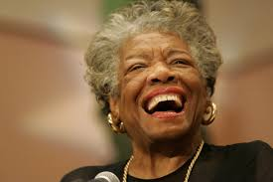
Who does this affect?
“I’ve run a game on everybody, and they’re going to figure me out.”
-Maya Angelou
Notes:
Attorneys are still practicing asbestos litigation? Why? Where?
Nationwide #’s:
For the first time, our data show a downward trend in both the total number of asbestos lawsuit filings, as well as a decrease in filings for every major disease type. While the 2017 filings received through January 2018 show a 17% decrease from the
2015 total, the decrease appears to have slowed somewhat. Filings in 2016 were down 10% from 2015; at this point, the
2017 total is down less than 8% from last year, and we anticipate getting more 2017 filings as we get further into 2018, which
will lessen this decrease.

Slide 8
Meryl Streep
Meryl Streep holds the most Academy Award nominations of any actor, having been nominated 21 times and winning three. Even still, she questioned her abilities, saying in a 2002 USA Weekend interview, “You think, ‘Why would anyone want to see me again in a movie? And I don’t know how to act anyway, so why am I doing this?’”
Notes:
The top 10 jurisdictions for mesothelioma filings, and the concentration of lawsuits within these jurisdictions, have stayed consistent over the past three years. Whereas 73% of all 2017 asbestos claims are concentrated in the top 10 jurisdictions overall, the concentration increases to 77% when looking at the top 10 mesothelioma jurisdictions in 2017. Madison County, Ill., continues to be the epicenter for the vast majority of mesothelioma claims, with eight times as many claims
as Philadelphia, Pa., the second most popular jurisdiction. Total mesothelioma claims are down 5% this year, and some
of the main filers saw significant decreases. Most dramatic is St. Louis, Mo., where mesothelioma filings dropped from
121 to 62 (49% decrease). In contrast, jurisdictions like Philadelphia and Middlesex, N.J., had increases in mesothelioma
filings of 32% and 26%, respectively.

Slide 9
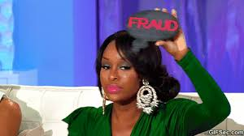
Tina Fey
Acclaimed comedian Tina Fey once admitted she has moments when she thinks to herself, “I’m a fraud! Oh god, they’re onto me! I’m a fraud!”
Notes:
Have any of you tried a mesothelioma case in Maury County, Tennessee? 2.1 million against Ameron yesterday afternoon with a 13% share for the family of James Davis, who passed away earlier this year. Maury County went 68% for Donald Trump in 2016. It turns out they still think product manufacturers causing mesothelioma is bad.
Please join me in congratulating Jim Long for a $7 million verdict in Buffalo, NY today against Jenkins Valves. He tried the case with Bill Papain from our office and our paralegal Terri Carini. The plaintiff, Mr. Stock, is 60 years old. He worked with packing and gaskets on Jenkins Valves from 1979 until the mid-1980s. Jim tried a great case with some difficult state of the art and causation issues. It’s one of the largest verdicts in Upstate New York and was a great team effort!
LA $8.45M verdict -60% on WM. Gary Paul and Erin Wood hit Weil-McLain yesterday in Los Angeles for an 8.45 million dollar verdict and a 60% share for the Swanson family in a mesothelioma death case tried under Michigan law. They needed to get a gross negligence finding to break the 750K damages cap under Michigan law, and they did. Almost three years ago, Gary was set to try this case and Weill-McLain took a writ on the Michigan law issue. Mr. Swanson died while the issue was on appeal. Justice was long in coming, but it arrived yesterday. Congratulations Gary and Erin. Oh yeah, W-M was represented by Ed McCambridge and David Glaspy, who were both involved in the Garlock RICO cases, not that I’m keeping score...
Big Shout Out to Dan Kraft, Lauren Hutwelker, and Ipek Medford on their verdict against Ford today in Wilmington, DE. After a month long trial, the jury found in our client’s favor, determined Ford negligent, its products defective and their conduct willful, wanton, malicious and reckless. The jury awarded $40,625,000 in compensatory damages for our 71 year old career automotive mechanic client who died in 2014 of pleural mesothelioma.The jury also awarded $1 million in punitive damages. We called Barry Castleman and Mark Ginsburg. We played 3 days of Jerry Kristal eviscerating Matt Fyie. Defense called Beasley, Gibb and Finley.Judge was Ferris Wharton. New Mexico law applied.
Our clients are Joanne and Gary Anderson. Joanne is 68 and used JJ on her children and while bowling. She has pleural mesothelioma.
Our Los Angeles County (West Covina) Jury was unanimous, 12-0, on all questions. The compensatory verdict amount is $21,752,508.16. They put 67% on JJ/JJCI since she had bystander brake/clutch exposure. The jury just added $4,000,000.00 in punitives. So the total verdict is $25,752,508.16.
Shrader & Associates who today achieved a verdict in Alameda, CA, on behalf of 61 year old Keneth Kramer in the amount of $6,800,000 ($1.8m in econs., $5m non-economic) with 20% fault finding against Amcord Inc. Mr. Kramer performed side jobs in the 1970s which put him in contact with Riverside gun plastic cement. He is 3 years since his mesothelioma diagnosis and we are all pulling for him. Judge Robert McGuiness presided over the case in Dept 21, Alameda.
Good news to announce a verdict for the Mata family in Long Beach California (Judge Flurer). Great trial team of Mark Bratt and Lenny Sandoval with help from many. Final defendant was Liberty Utilities Park Water Corp. Jury awarded $2,550,000 pain and suffering to Alfred Mata, $3,000,000 loss of consortium to Leticia Mata. Park water was found 54% responsible. Jury also awarded $856,500 in economic damages and $5,000,000 in punitive damages.
(Simmons) Please join me in congratulating the trial team of Daniel Blouin and Jim Kramer in our New York office for their $60 million verdict this morning in New York City. Dan and Jim tried the case on behalf of the Macaluso family. Pietro Macaluso died at age 56 from pleural meso, leaving behind his twin 11 year-olds, who had their own wrongful death claim. Pietro was exposed to boilers manufactured by AO Smith, Burnham, and Peerless, as well as other boilers and joint compound products. The jury followed Dan and Jim’s suggestions, and put 25% each on AO Smith, Burnham, and Peerless, and found all three reckless.
PALS: The extraordinary trial team of Moshe Maimon (Levy Konigsberg) and Joe Satterley and Denyse Clancy (Kazan McClain Satterley and Greenwood) won an 80 million dollar punitive damages verdict (25M on Imerys and 55M on J&J Consumer Inc). This is on top of the 37 million compensatory damages verdict (70 % on JJCI and 30% on Imerys). Moshe told the jury in closing to tell these companies that what they did was "outrageous and egregious", to tell them "to stop" and to "never do it again." He asked them to speak loudly and they did!
With Simona Farrise leading the charge, a California jury awarded $18.75MM in punitives against MetalClad today. Before this case they were Metalglad but now they’re just Metalsad. I am thrilled to report that Ben Adams, first chairing his first mesothelioma case, and Simona Farrise just received a verdict against Metalclad for its negligence in conducting abatement work at SoCal Edison and exposing our client, Hortencia Gomez, to asbestos during that abatement work. The verdict amount is $7.5MM -- 87.5% to Metalclad for a total of $26.25M

Slide 10
Emma Watson
In 2013, Harry Potter actress Emma Watson revealed in Rookie magazine, “It’s almost like the better I do, the more my feeling of inadequacy actually increases, because I’m just going, ‘Any moment, someone’s going to find out I’m a total fraud, and that I don’t deserve any of what I’ve achieved.”
Notes:
Big Shout Out to Dan Kraft, Lauren Hutwelker, and Ipek Medford on their verdict against Ford today in Wilmington, DE. After a month long trial, the jury found in our client’s favor, determined Ford negligent, its products defective and their conduct willful, wanton, malicious and reckless. The jury awarded $40,625,000 in compensatory damages for our 71 year old career automotive mechanic client who died in 2014 of pleural mesothelioma.The jury also awarded $1 million in punitive damages. We called Barry Castleman and Mark Ginsburg. We played 3 days of Jerry Kristal eviscerating Matt Fyie. Defense called Beasley, Gibb and Finley.Judge was Ferris Wharton. New Mexico law applied.
Our clients are Joanne and Gary Anderson. Joanne is 68 and used JJ on her children and while bowling. She has pleural mesothelioma.
Our Los Angeles County (West Covina) Jury was unanimous, 12-0, on all questions. The compensatory verdict amount is $21,752,508.16. They put 67% on JJ/JJCI since she had bystander brake/clutch exposure. The jury just added $4,000,000.00 in punitives. So the total verdict is $25,752,508.16.
Shrader & Associates who today achieved a verdict in Alameda, CA, on behalf of 61 year old Keneth Kramer in the amount of $6,800,000 ($1.8m in econs., $5m non-economic) with 20% fault finding against Amcord Inc. Mr. Kramer performed side jobs in the 1970s which put him in contact with Riverside gun plastic cement. He is 3 years since his mesothelioma diagnosis and we are all pulling for him. Judge Robert McGuiness presided over the case in Dept 21, Alameda.
Good news to announce a verdict for the Mata family in Long Beach California (Judge Flurer). Great trial team of Mark Bratt and Lenny Sandoval with help from many. Final defendant was Liberty Utilities Park Water Corp. Jury awarded $2,550,000 pain and suffering to Alfred Mata, $3,000,000 loss of consortium to Leticia Mata. Park water was found 54% responsible. Jury also awarded $856,500 in economic damages and $5,000,000 in punitive damages.
(Simmons) Please join me in congratulating the trial team of Daniel Blouin and Jim Kramer in our New York office for their $60 million verdict this morning in New York City. Dan and Jim tried the case on behalf of the Macaluso family. Pietro Macaluso died at age 56 from pleural meso, leaving behind his twin 11 year-olds, who had their own wrongful death claim. Pietro was exposed to boilers manufactured by AO Smith, Burnham, and Peerless, as well as other boilers and joint compound products. The jury followed Dan and Jim’s suggestions, and put 25% each on AO Smith, Burnham, and Peerless, and found all three reckless.
PALS: The extraordinary trial team of Moshe Maimon (Levy Konigsberg) and Joe Satterley and Denyse Clancy (Kazan McClain Satterley and Greenwood) won an 80 million dollar punitive damages verdict (25M on Imerys and 55M on J&J Consumer Inc). This is on top of the 37 million compensatory damages verdict (70 % on JJCI and 30% on Imerys). Moshe told the jury in closing to tell these companies that what they did was "outrageous and egregious", to tell them "to stop" and to "never do it again." He asked them to speak loudly and they did!
With Simona Farrise leading the charge, a California jury awarded $18.75MM in punitives against MetalClad today. Before this case they were Metalglad but now they’re just Metalsad. I am thrilled to report that Ben Adams, first chairing his first mesothelioma case, and Simona Farrise just received a verdict against Metalclad for its negligence in conducting abatement work at SoCal Edison and exposing our client, Hortencia Gomez, to asbestos during that abatement work. The verdict amount is $7.5MM -- 87.5% to Metalclad for a total of $26.25M

Slide 11
Jodi Foster
Jodie Foster won two Best Actress Oscars for her performances in The Accused and The Silence of the Lambs. Still, Foster was worried she’d be discovered to be a fraud. “I thought everybody would find out, and they’d take the Oscar back. They’d come to my house, knocking on the door, ‘Excuse me, we meant to give that to someone else,’” the star admitted.

Slide 12
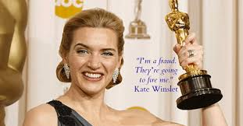
Kate Winslet

Slide 13
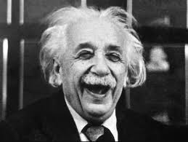
Men go through it too…
Albert Einstein stated he was an “involuntary swindler” whose work did not deserve as much attention as it had received.
*KCIC 2017 Asbestos Litigation Report

Slide 14
Where did this start?
Psychologist Dr. Pauline Rose Clance was the first to study this unwarranted sense of insecurity.
She also developed the “Impostor Phenomenon” test.
http://paulineroseclance.com/pdf/IPTestandscoring.pdf
Notes:
Once again, we see the same jurisdictions dominating asbestos litigation. While the locations that make up the top jurisdictions for asbestos filings have not changed much year over year, the number of filings in some of these places has changed significantly since 2016. For instance, Madison County, Ill., which has long been at the top of the list, has seen a 13% decrease in filings between 2016 and 2017. Other top jurisdictions, such as Baltimore City, Md.;
St. Louis, Mo.; and New Castle, Del., have also seen a decrease of 10%, 40% and 10%, respectively. At the same time, jurisdictions such as St. Clair and Cook counties in Illinois have increased 200% and 15%, and in Kanawha, W. Va., filings have gone up almost 25%.

Slide 15
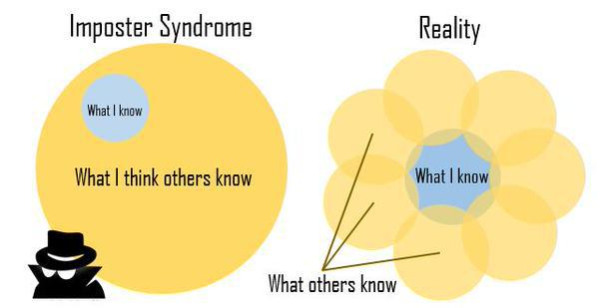
Overcoming Impostorism
Name the feeling. Sharing your experiences with others allows you to see them in a more positive light.
*KCIC 2017 Asbestos Litigation Report
Notes:
Once again, we see the same jurisdictions dominating asbestos litigation. While the locations that make up the top jurisdictions for asbestos filings have not changed much year over year, the number of filings in some of these places has changed significantly since 2016. For instance, Madison County, Ill., which has long been at the top of the list, has seen a 13% decrease in filings between 2016 and 2017. Other top jurisdictions, such as Baltimore City, Md.;
St. Louis, Mo.; and New Castle, Del., have also seen a decrease of 10%, 40% and 10%, respectively. At the same time, jurisdictions such as St. Clair and Cook counties in Illinois have increased 200% and 15%, and in Kanawha, W. Va., filings have gone up almost 25%.

Slide 16
Overcoming Imposterism
Know your values: when you think of times when you were happiest or the most satisfied, which values come to mind?
*KCIC 2017 Asbestos Litigation Report
Notes:
Once again, we see the same jurisdictions dominating asbestos litigation. While the locations that make up the top jurisdictions for asbestos filings have not changed much year over year, the number of filings in some of these places has changed significantly since 2016. For instance, Madison County, Ill., which has long been at the top of the list, has seen a 13% decrease in filings between 2016 and 2017. Other top jurisdictions, such as Baltimore City, Md.;
St. Louis, Mo.; and New Castle, Del., have also seen a decrease of 10%, 40% and 10%, respectively. At the same time, jurisdictions such as St. Clair and Cook counties in Illinois have increased 200% and 15%, and in Kanawha, W. Va., filings have gone up almost 25%.

Slide 17
Overcoming Impostorism
Celebrate your successes – all of them!
Write down compliments you receive or positive feedback.
Write or draw 1-3 things that you have accomplished.
Write about or draw a picture about 1-3 personal qualities or skills that you possess.

Slide 18
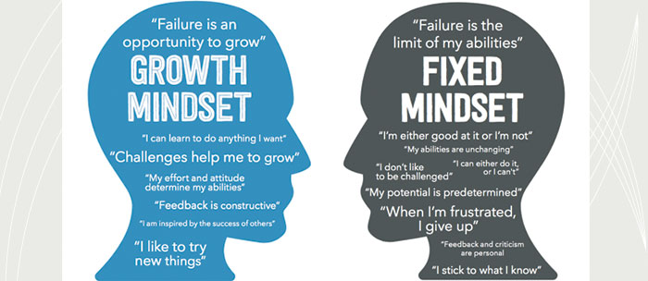
Overcoming Impostorism
Understand the growth mindset
https://cuwip.physics.iastate.edu/files/page/files/impostor_syndrome.pdf

Slide 19
Key Takeaways
1. Recognize that “it” exists.
2. Embrace and internalize positive feedback.
3. Do not attribute your success to luck.
4. Do not diminish your abilities.
Avoid the words “merely”, “only”, “simply”
5. Accept that no one knows everything.
6. Accept help from others.
7. Embrace failure and a growth-mindset!
https://cuwip.physics.iastate.edu/files/page/files/impostor_syndrome.pdf

Slide 20
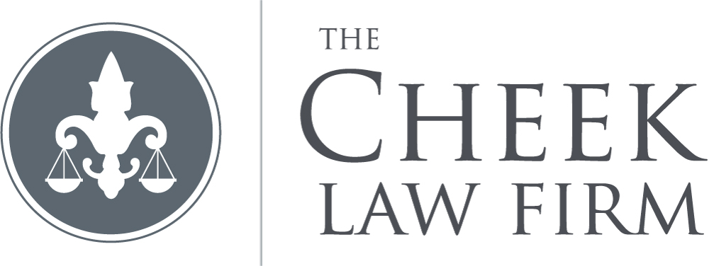
Lindsey A. Cheek
lcheek@thecheeklawfirm.com
Bridget B. Truxillo
btruxillo@thecheeklawfirm.com
Rubi L. Brown
rbrown@thecheeklawfirm.com
650 Poydras, Ste. 2310, New Orleans, LA 70130

